Slide 1
PYTHON

Slide 2
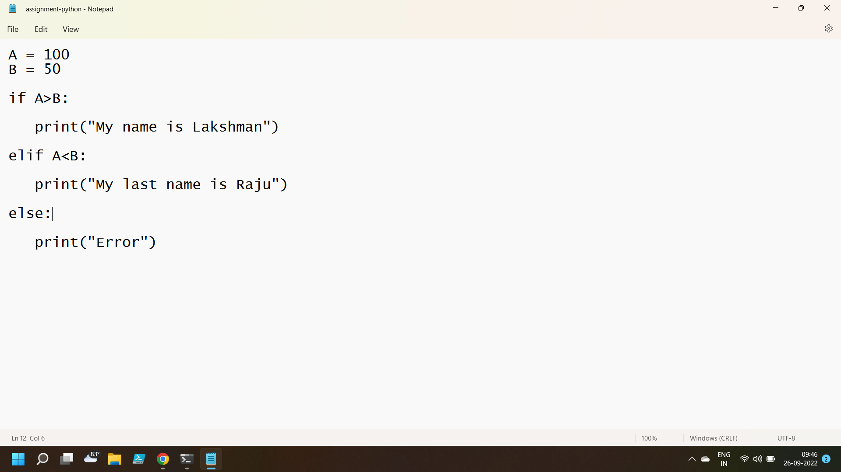
Creating a notepad file with python program

Slide 3
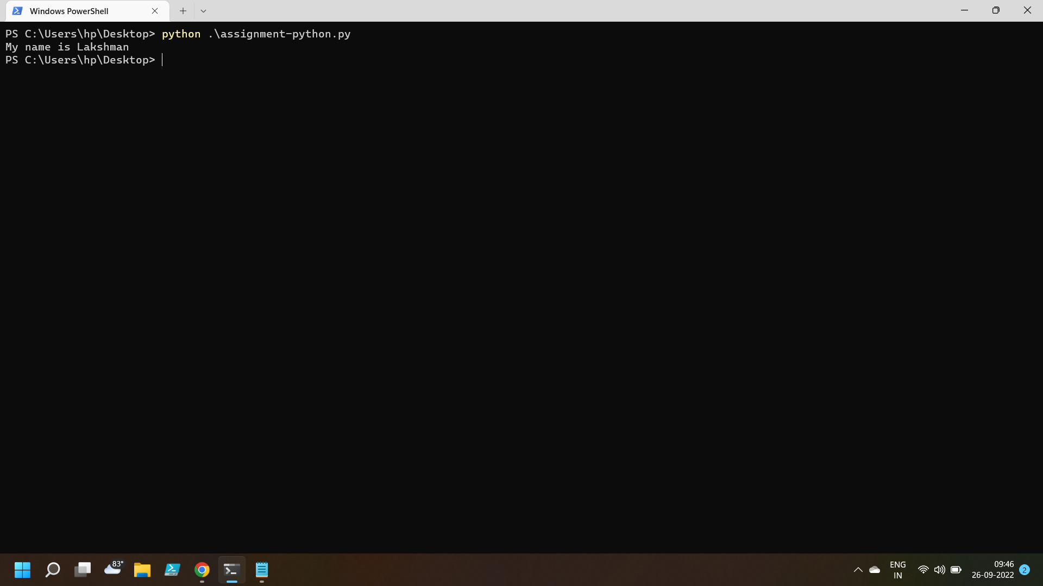
A is greater than B so it will print Lakshman

Slide 4
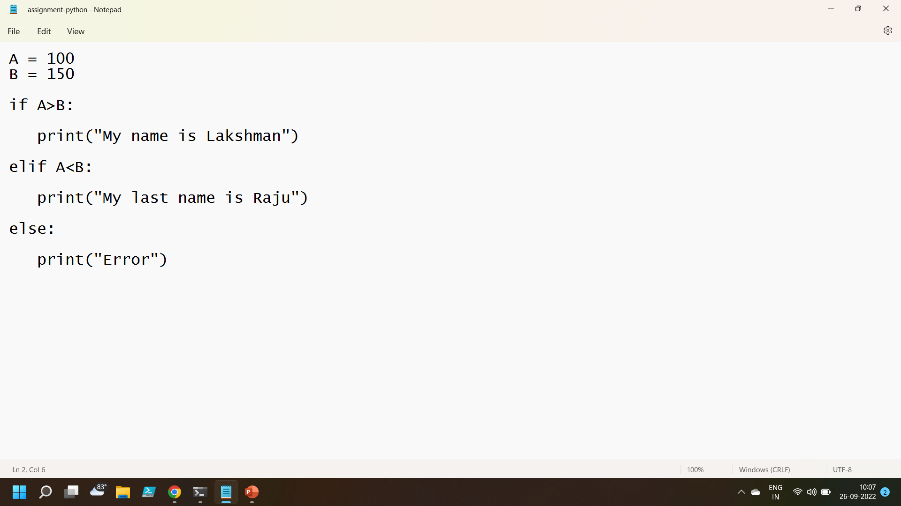
I made some changes to the program to check else if

Slide 5
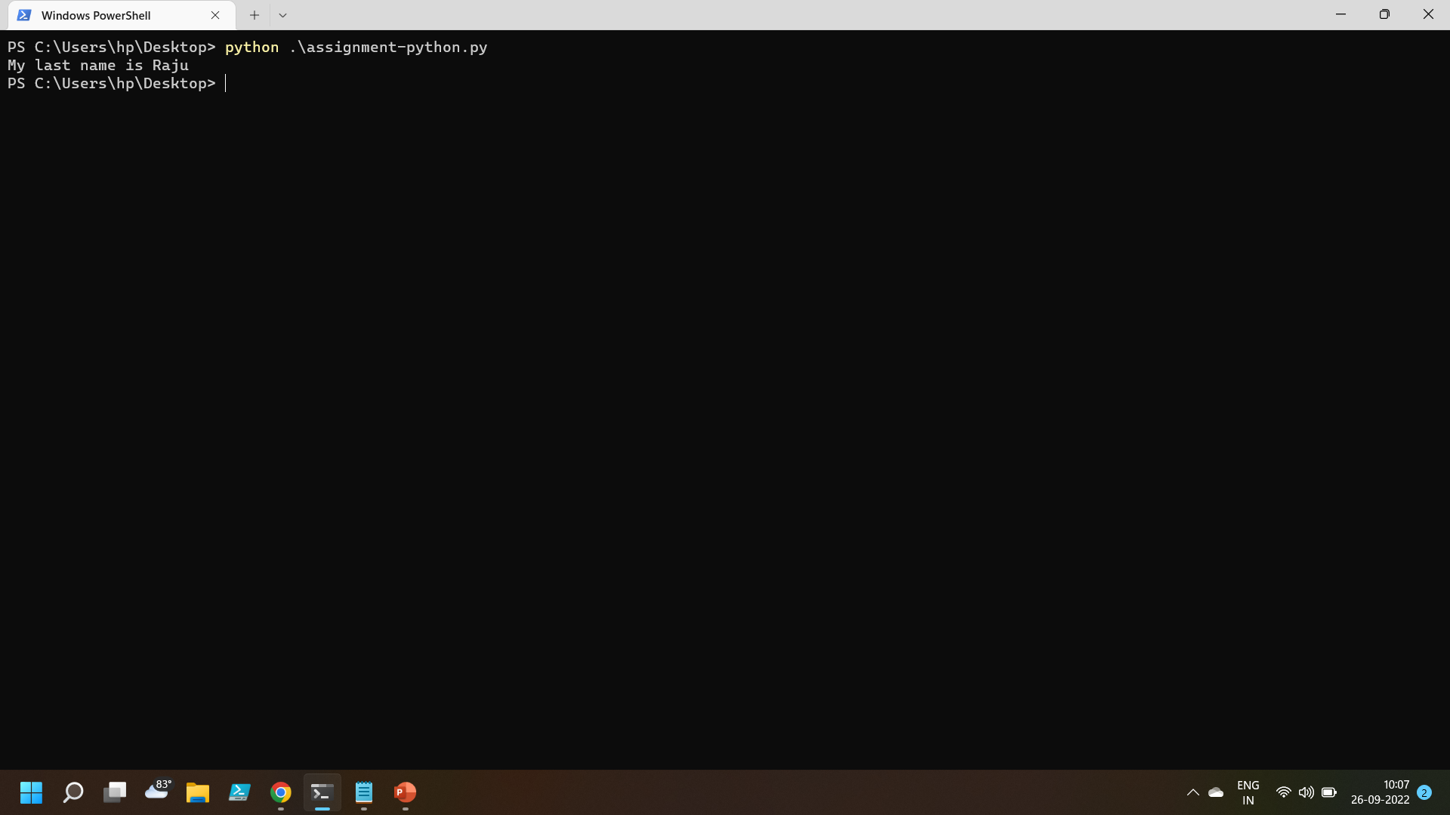
A is less than B so it will execute else if loop and print Raju

Slide 6

I made some changes to the python program so that it will execute else loop

Slide 7
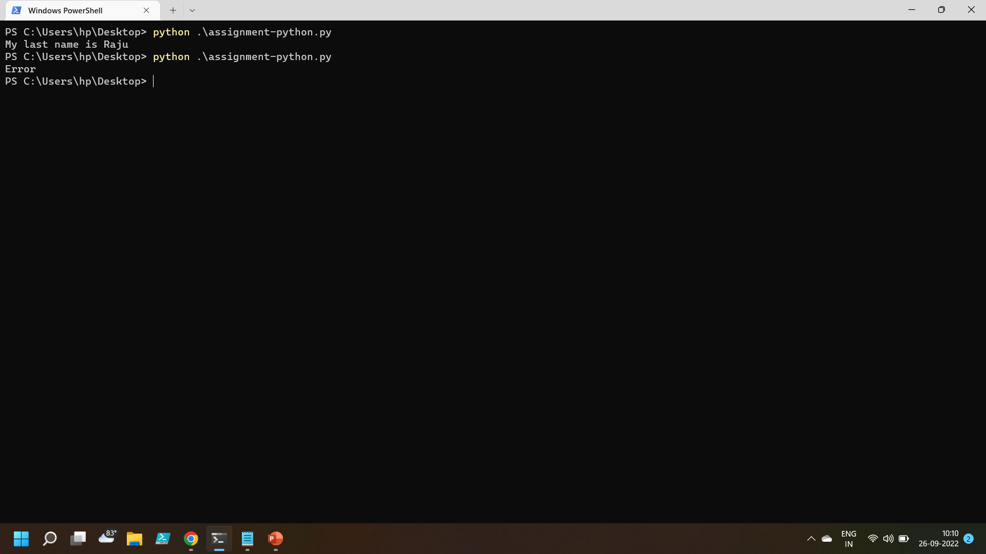
A is equal to B so it will execute else loop and print Error

Slide 8
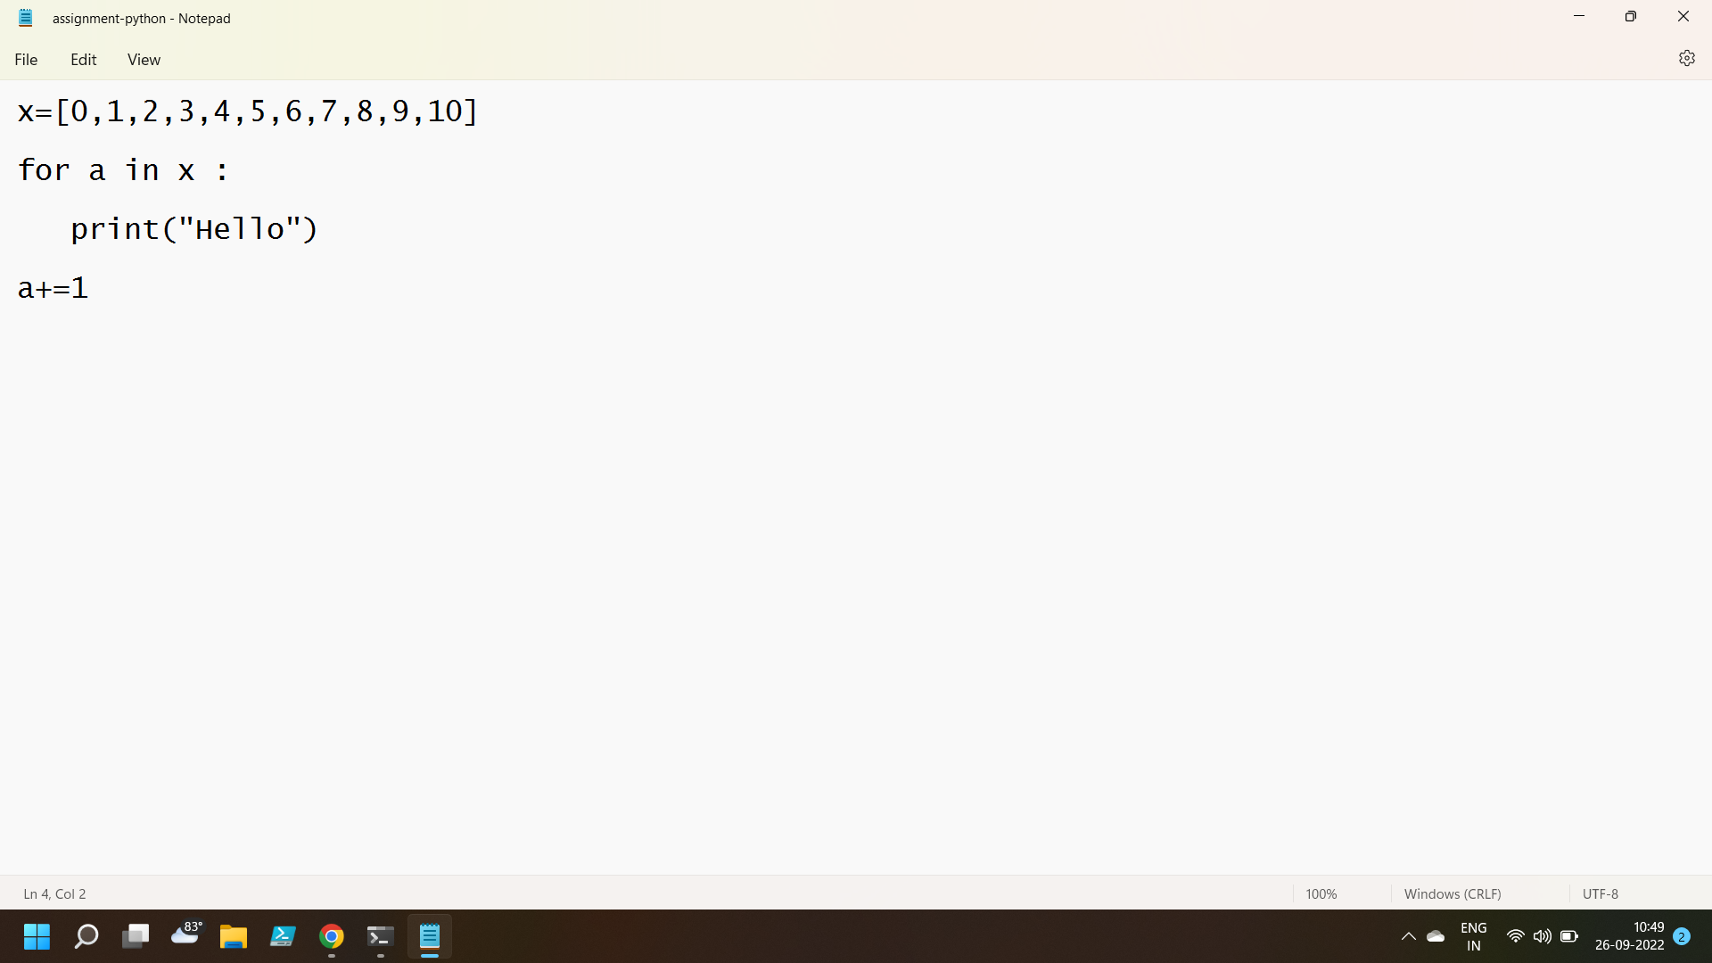
FOR Loop

Slide 9
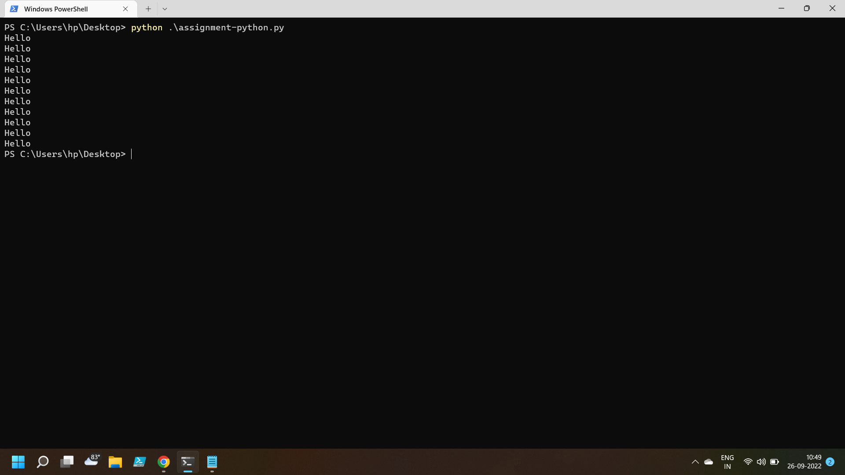
Loop executing 10 times

Slide 10
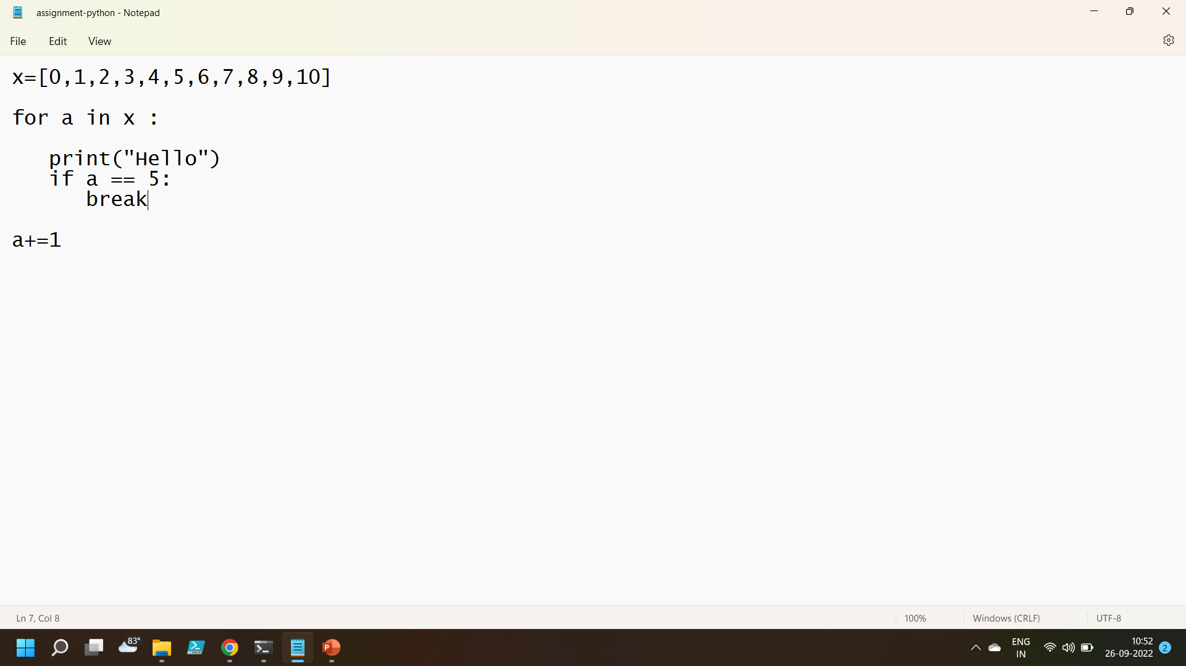
Checking break

Slide 11
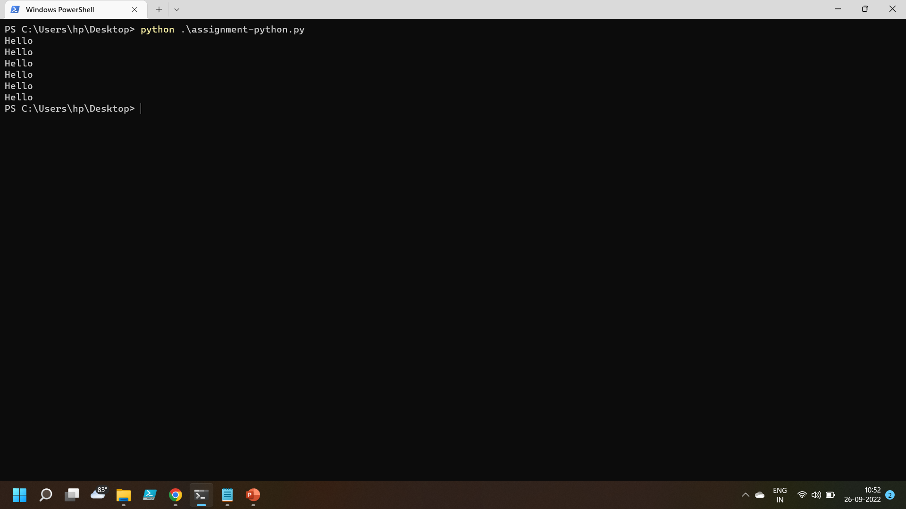
It breaks the loop whenever value of a becomes 5

